Slide 1
Traffic Sign Detection And Classification Using Deep Learning And Model Comparison

Slide 2
Shadman Sakib | 1813190642
Talukder Abdullah Al Talha | 1813193642
Md. Sharukh Fardin | 1821463042

Slide 3
What Is Our Project?
The job of our project is to detect and classify the roadside traffic signs. We basically want to help those drivers by our project who are unable to identify and understand the actual meaning of traffic signs for some reasons like bad eyesight , lack of proper knowledge and also for bad light etc. In our system, drivers will be notified about traffic signs by a text or a voice message and the meaning of the signs will also be given.
The accuracy of three models : Faster RCNN, YOLO v5 and SSD will also be compared.
In the future, we will try to develop our project for automated cars.

Slide 4
What Did We Learn In CSE499A?
How to find suitable informations about our project from related research papers.
How to collect good quality of dataset.
How to complete annotation and labeling of the dataset efficiently.

Slide 5
Specification
Dataset collection and labeling.
Dataset pre-processing.
Architecture of model.
Model training.
Model evaluation.

Slide 6
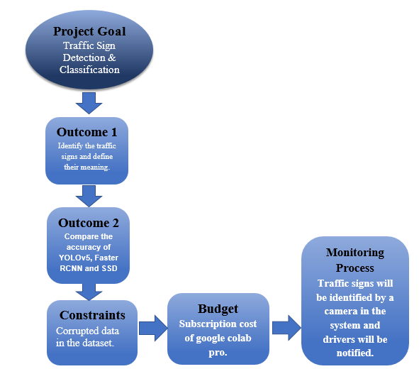
Project Design

Slide 7
Thank You

